Slide 1
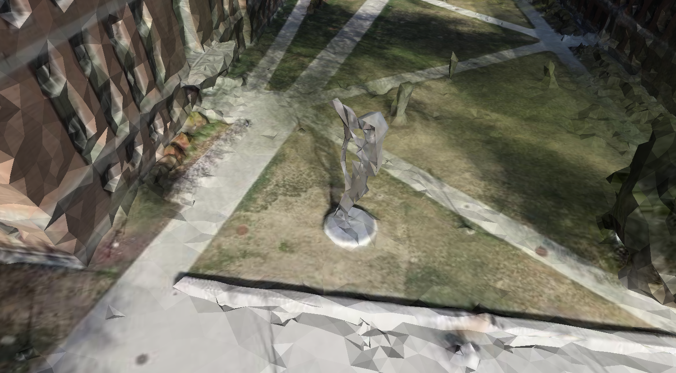

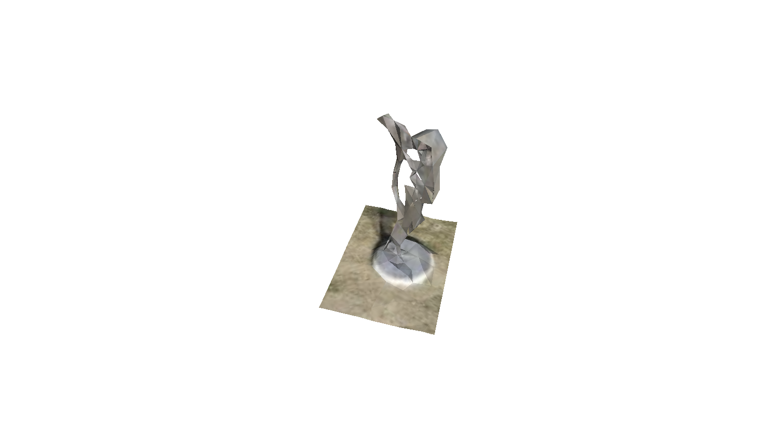
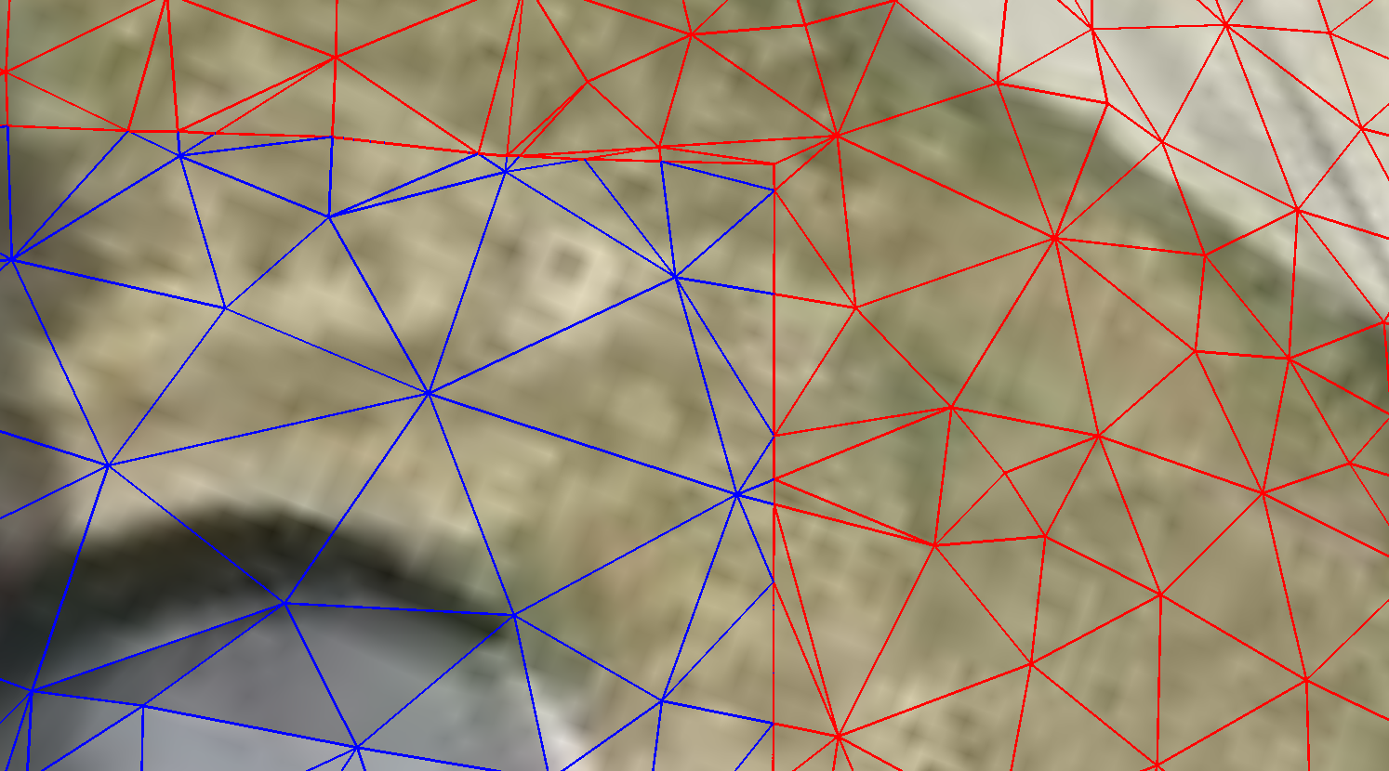
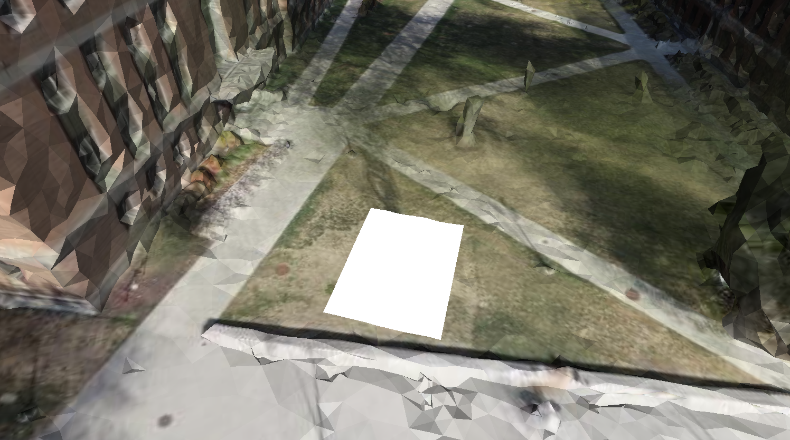
Outside
Inside

Slide 2
Outside
Inside

Slide 3
Out
8
Out
1
2
3
7
0
In
In
6
4
5
Step1: Identity intersection points
(9 types)
Step2: Triangulation

Slide 4
Type | #v inside AOI | #e intersect AOI | AOI corner in Triangle
0 | 3 | 0 | False
1 | 1 | 2 | False
2 | 2 | 2 | False
3 | 1 | 2 | True
4 | 2 | 2 | True
5 | 0 | 1 | True
6 | 0 | 2 | False
7 | 1 | 3 | False
8 | 0 | 0 | False

